Slide 1

Reddit Sentiment Analysis:
Exploring Online Conversations
Team 10 – Tony Afuti, Luke Henkel,
Vanessa Hernandez, Brendon Matsikinya

Slide 2







Our Approach
Data Collection
Gathered posts from Reddit API
Processing
Organized 9,600 posts across 100 subreddits
AI Analysis
Used Gemini API for sentiment classification
Interpretation
Analyzed patterns across categories using PySpark

Slide 3


About the dataset we created:
~9,600
Reddit posts in our data set, from a 24-hour collection period
(April 12th-April 13th, 2025)
Uses Gemini API and keyword detection for robust sentiment analysis
Includes like counts after 3 and 8 hours, as well as the top comment for each post

Slide 4
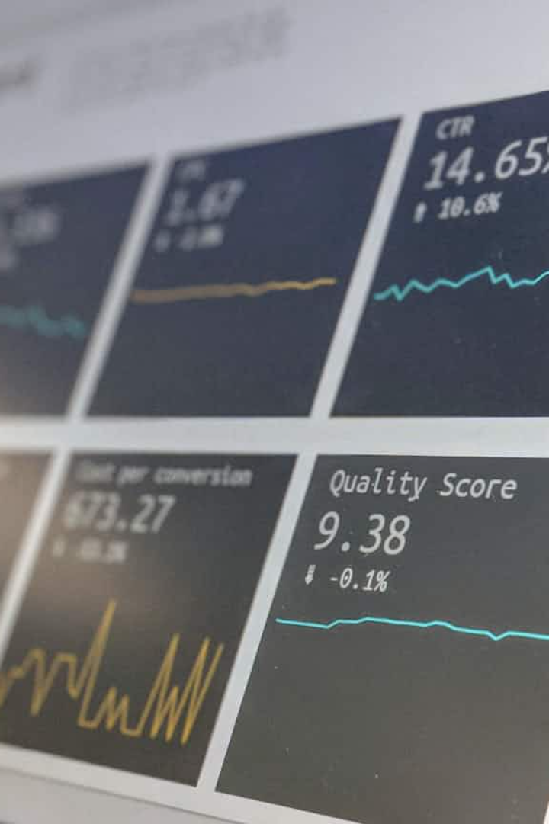
Data Variables
Post Content
Titles and descriptions; taken from 100 subreddits
Engagement Metrics
Upvote counts and top comments; taken in the hours after posting
Sentiment Labels
Positive, neutral, or negative; done using Gemini API
Subreddit Category
8 different topics in our analysis

Slide 5
















Content Categories
Education
Entertainment
Learning and academic discussions
Media, games, and leisure activities
News
Finance
Current events and reporting
Money management and investments
Humor
Relationships
Comedy and lighthearted content
Personal connections and advice
Wellbeing
Tech
Health and personal improvement
Technology discussions and news

Slide 6



Key Findings: What do People use Reddit for?
Entertainment
News
Advice
The average humor subreddit thread has over 1,000 likes within 8 hours
Despite Reddit not being a true
"news outlet"
Over 1/3 of total posts
Notes:
Based on our key findings, we discovered that many people use this platform for entertainment, as humor threads often receive over 1,000 likes within just 8 hours; for news, even though reddit isn’t a formal news platform, users frequently rely on it as a source of current events and discussions; and for advice, with nearly one in three posts involving someone seeking guidance or input from the community.

Slide 7

Our most Popular Reddit Post?
"There’s always one 😂"
Notes:
3 days ago, this post became our most popular and rapidly trending content, achieving peak engagement within just three hours.

Slide 8
Other popular posts?
"'Correct mistakes': China calls on US to 'completely cancel' reciprocal tariffs "
"Never interrupt your enemy while he is making a mistake."
"KFC Announces Bankruptcy & Closure Of All 537 Outlets In Turkey"
"Zelenskyy on Russian attack on Sumy: 'Only scum can act like this'"
Notes:
These are some of our posts that represent a range of high-engagement content from our dataset, including breaking news, emotionally charged commentary, and real-time reactions to current events.

Slide 9
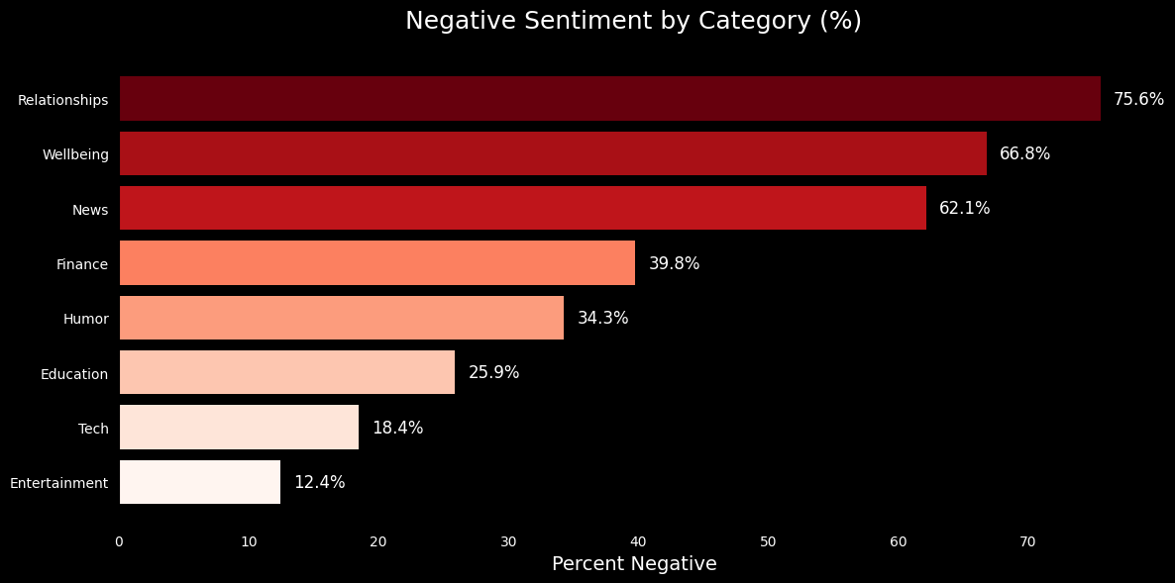
Key Findings: People aren't afraid to be negative
Notes:
People get the most negative when talking about relationships, wellbeing, and the news. Lighter topics like tech and entertainment? Not so much. Looks like the more personal or stressful the topic, the more likely folks are to vent.

Slide 10
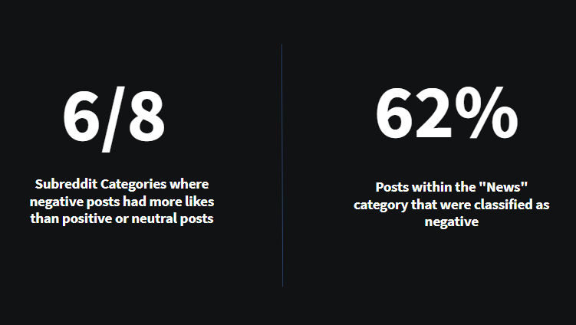
Key Findings: People aren't afraid to be negative
Notes:
Negative content gets attention. in 6 out of 8 categories, negative posts got more likes than positive or neutral ones. and in the news category, 62% of posts were negative, This shows how users often engage most with critical content.

Slide 11
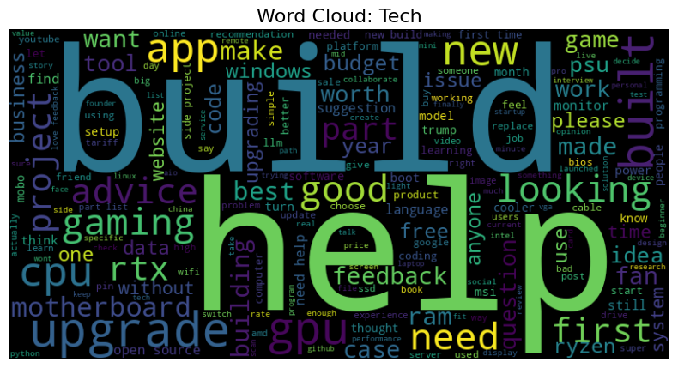
Keyword Analysis: What are people talking about?
Notes:
Common Topics in Tech Conversations, we words like “build,” “help,” “upgrade,” “gpu,” “cpu,” and “advice”

Slide 12
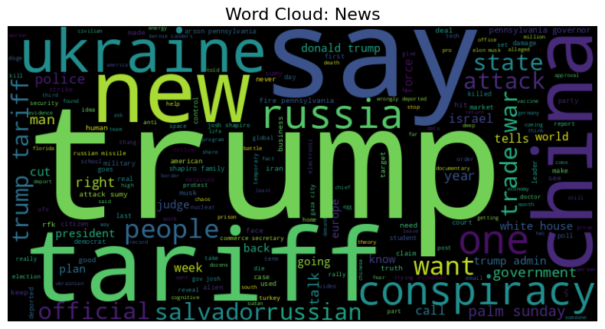
Keyword Analysis: What are people talking about?
Notes:
In News Discussions: we have words like “trump,” “tariff,” “ukraine,” “russia,” and “conspiracy”

Slide 13
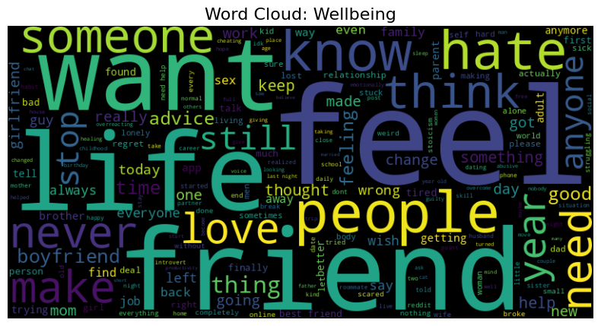
Keyword Analysis: What are people talking about?
Notes:
In Emotional Wellbeing: words like “feel,” “life,” “want,” “friend,” “love,” and “people”

Slide 14








Business Applications
Targeted Marketing
Match content to community sentiment
Product Feedback
Monitor reactions to launches or updates
Trend Prediction
Identify emerging topics and interests
Reputation Management
Track brand perception across communities
Notes:
We wanted to go beyond just analyzing Reddit posts — we wanted to see how companies could actually use this kind of data to make decisions. Whether it's marketing, product feedback, or tracking trends, there are a lot of practical ways sentiment analysis like this can be valuable. Let’s take a look at some of those applications.
With pyspark – can be used for 10s of thousands or millions
And the competition of how other products may be more favored currently

Slide 15




Market Implementation
Audience Research
Identify target communities
Content Strategy
Develop tone matching community sentiment
Performance Tracking
Monitor sentiment shifts over time
Notes:
Main benefit for companies
Automated market researcher
No manual focus groups, automitc focus groups always

Slide 16


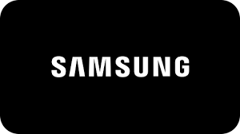

Business Case: How could Apple use our system?
Notes:
New iphone or ios update
Tech, wellbeing, finance
Tech: speed, new features
Wellbeing: screen time or impacts on phone usage
Different types of users , product messaging, patch updates, feature prioriztization, all based on real user feedback

Slide 17





Potential Improvements to Consider
Broader Dataset
Deeper Analysis
Advanced ML
Industry Partnerships
Implement more nuanced sentiment models
Include more platforms beyond Reddit
Explore linguistic patterns and emotion
Collaborate with businesses for real-world testing
Notes:
Twitter, tiktok
Recognize sarcasm, tone changes along the description
This can be useful as a plug and play, so a different api is used
An ML can be created to better access emotions , instead of gemini
Scaling is not an issue

Slide 18



